Slide 1



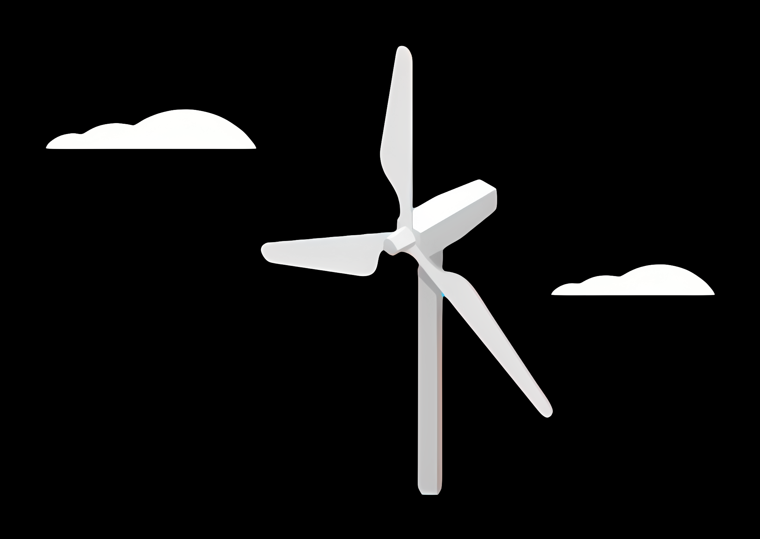
Weekly report: Load & Dynamics
Week number: 04
Date: 21/10/2025
Supervisor: Mr. Manjock
Group members: Md Aman, Arham Memon, Paresh Nakum
Presenter – Md Aman
21/10/2025
Md Aman, Arham Memon, Paresh Nakum
Optimus Syria

Slide 2
Agenda
Tip Deflection
Wind Field Simulation
4 m/s
8.64 m/s annual mean wind speed
24 m/s
Wind Turbine classes
Dynamic Simulation
Future Plan
Bibliography
21/10/2025
Md Aman
Load & Dynamics Team/ Optimus Syria

Slide 3
Tip Deflection
Tip deflection in a wind turbine refers to how much the tip of a turbine blade bends or moves from its original (undeformed) position when the turbine is operating — mainly due to aerodynamic, gravitational, and inertial loads.
It is Important because of
Structural Safety – prevents from tower strike
Fatigue – prevents from flexing damage
NREL’s 2022 study comparing aeroelastic methods notes the regime where out-of-plane tip deflections exceed about 5% of blade length (and in-plane >1.25%) — above this the usual BEM methods underpredict and the blade is considered “highly flexible.” (NREL uses this as guidance to switch methods). For an 80 m blade, 5% = 4.0 m
21/10/2025
3
Md Aman
Load & Dynamics Team/ Optimus Syria

Slide 4
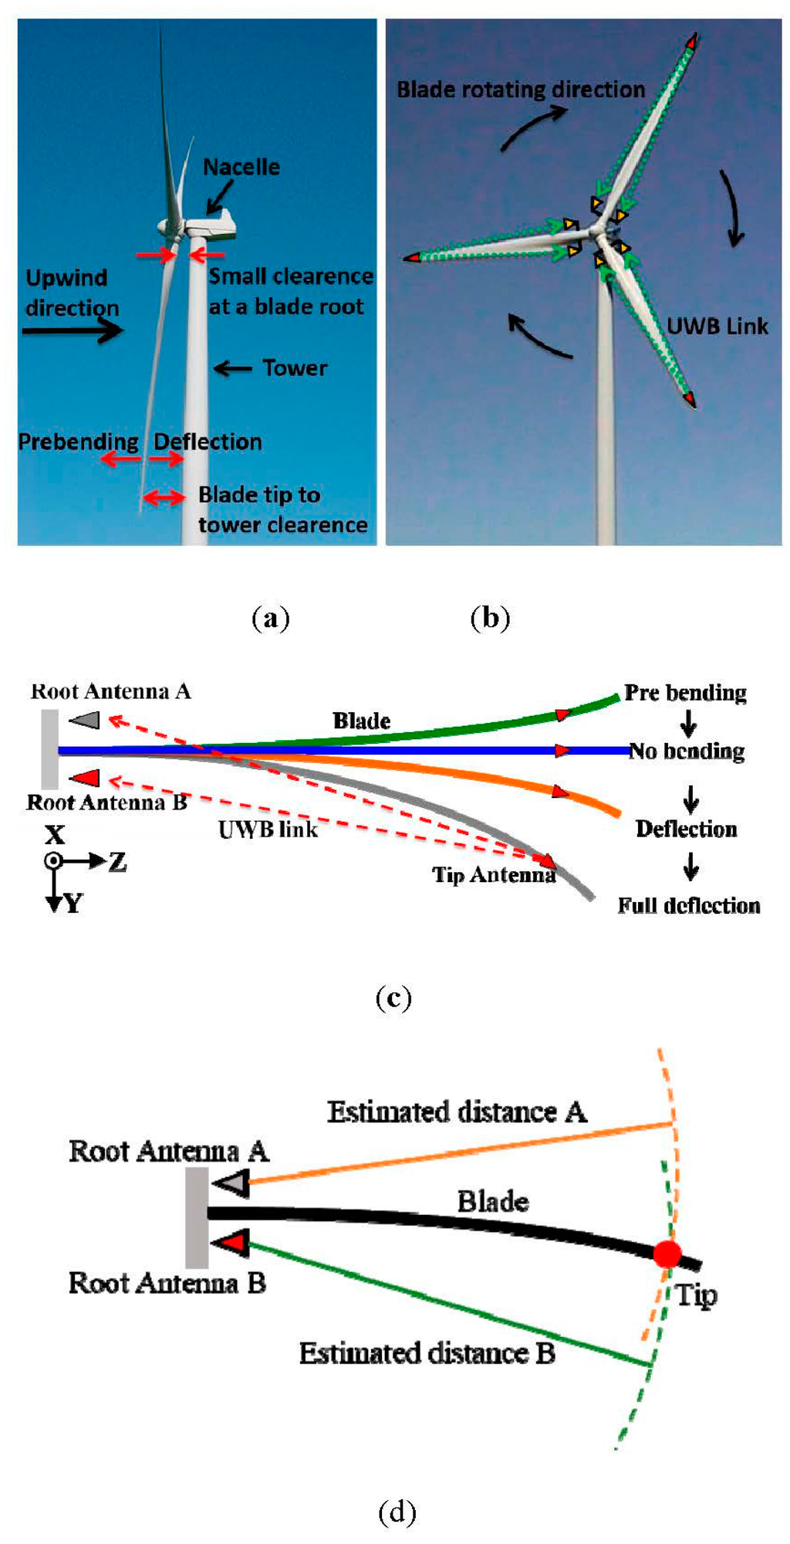
Tip Deflection
*LM Wind Power, Jupitervej 6, Kolding DK-6000, Denmark
21/10/2025
4
Md Aman
Load & Dynamics Team/ Optimus Syria

Slide 5
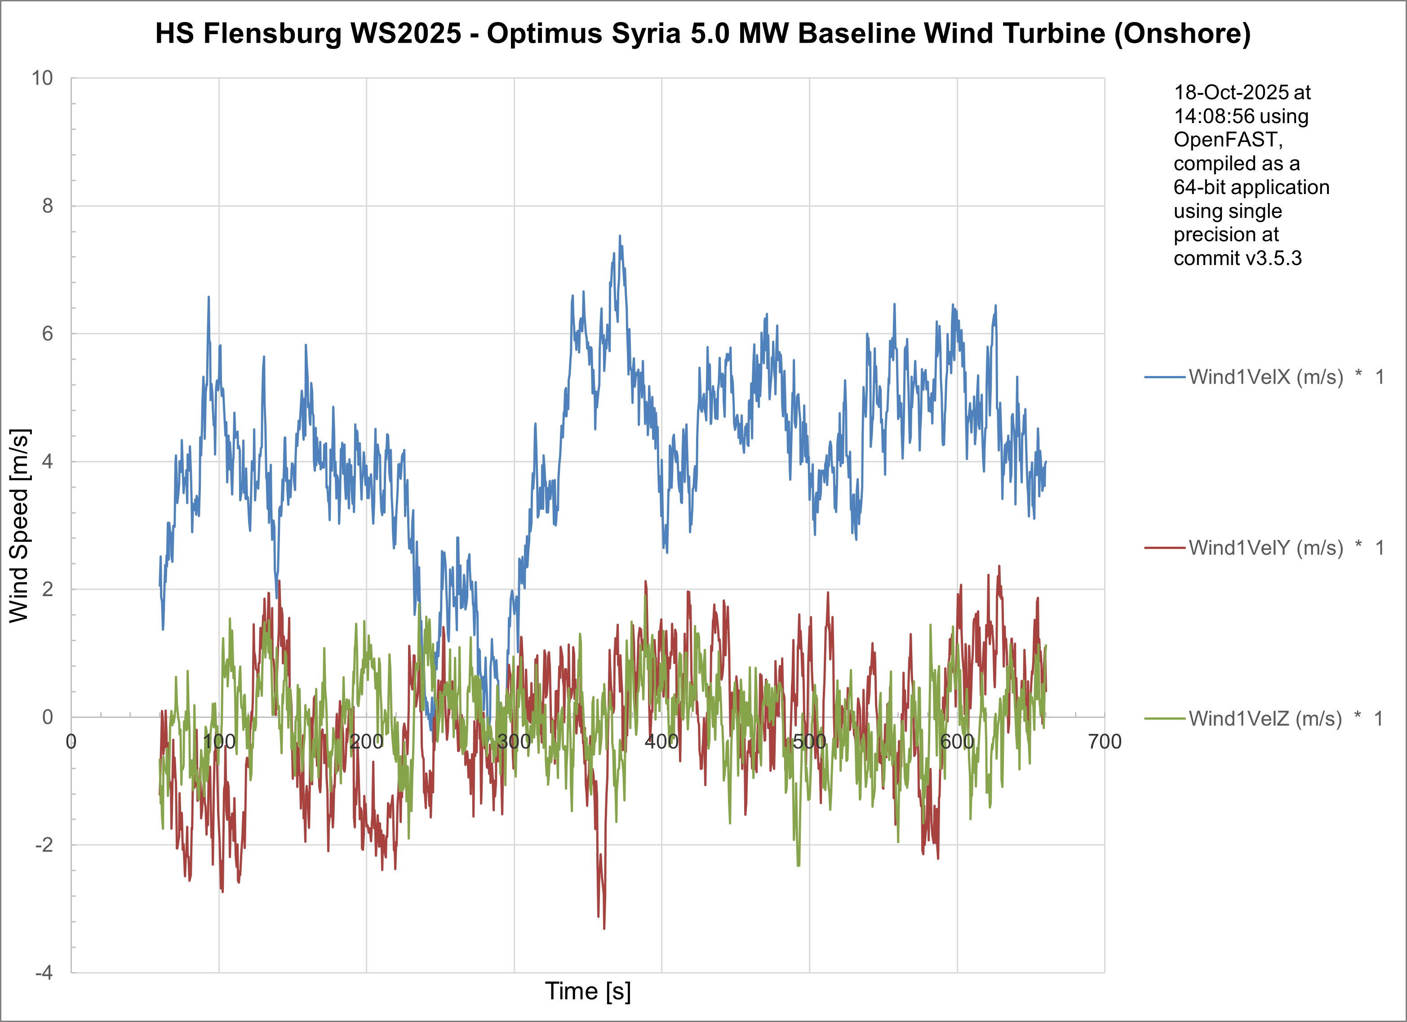
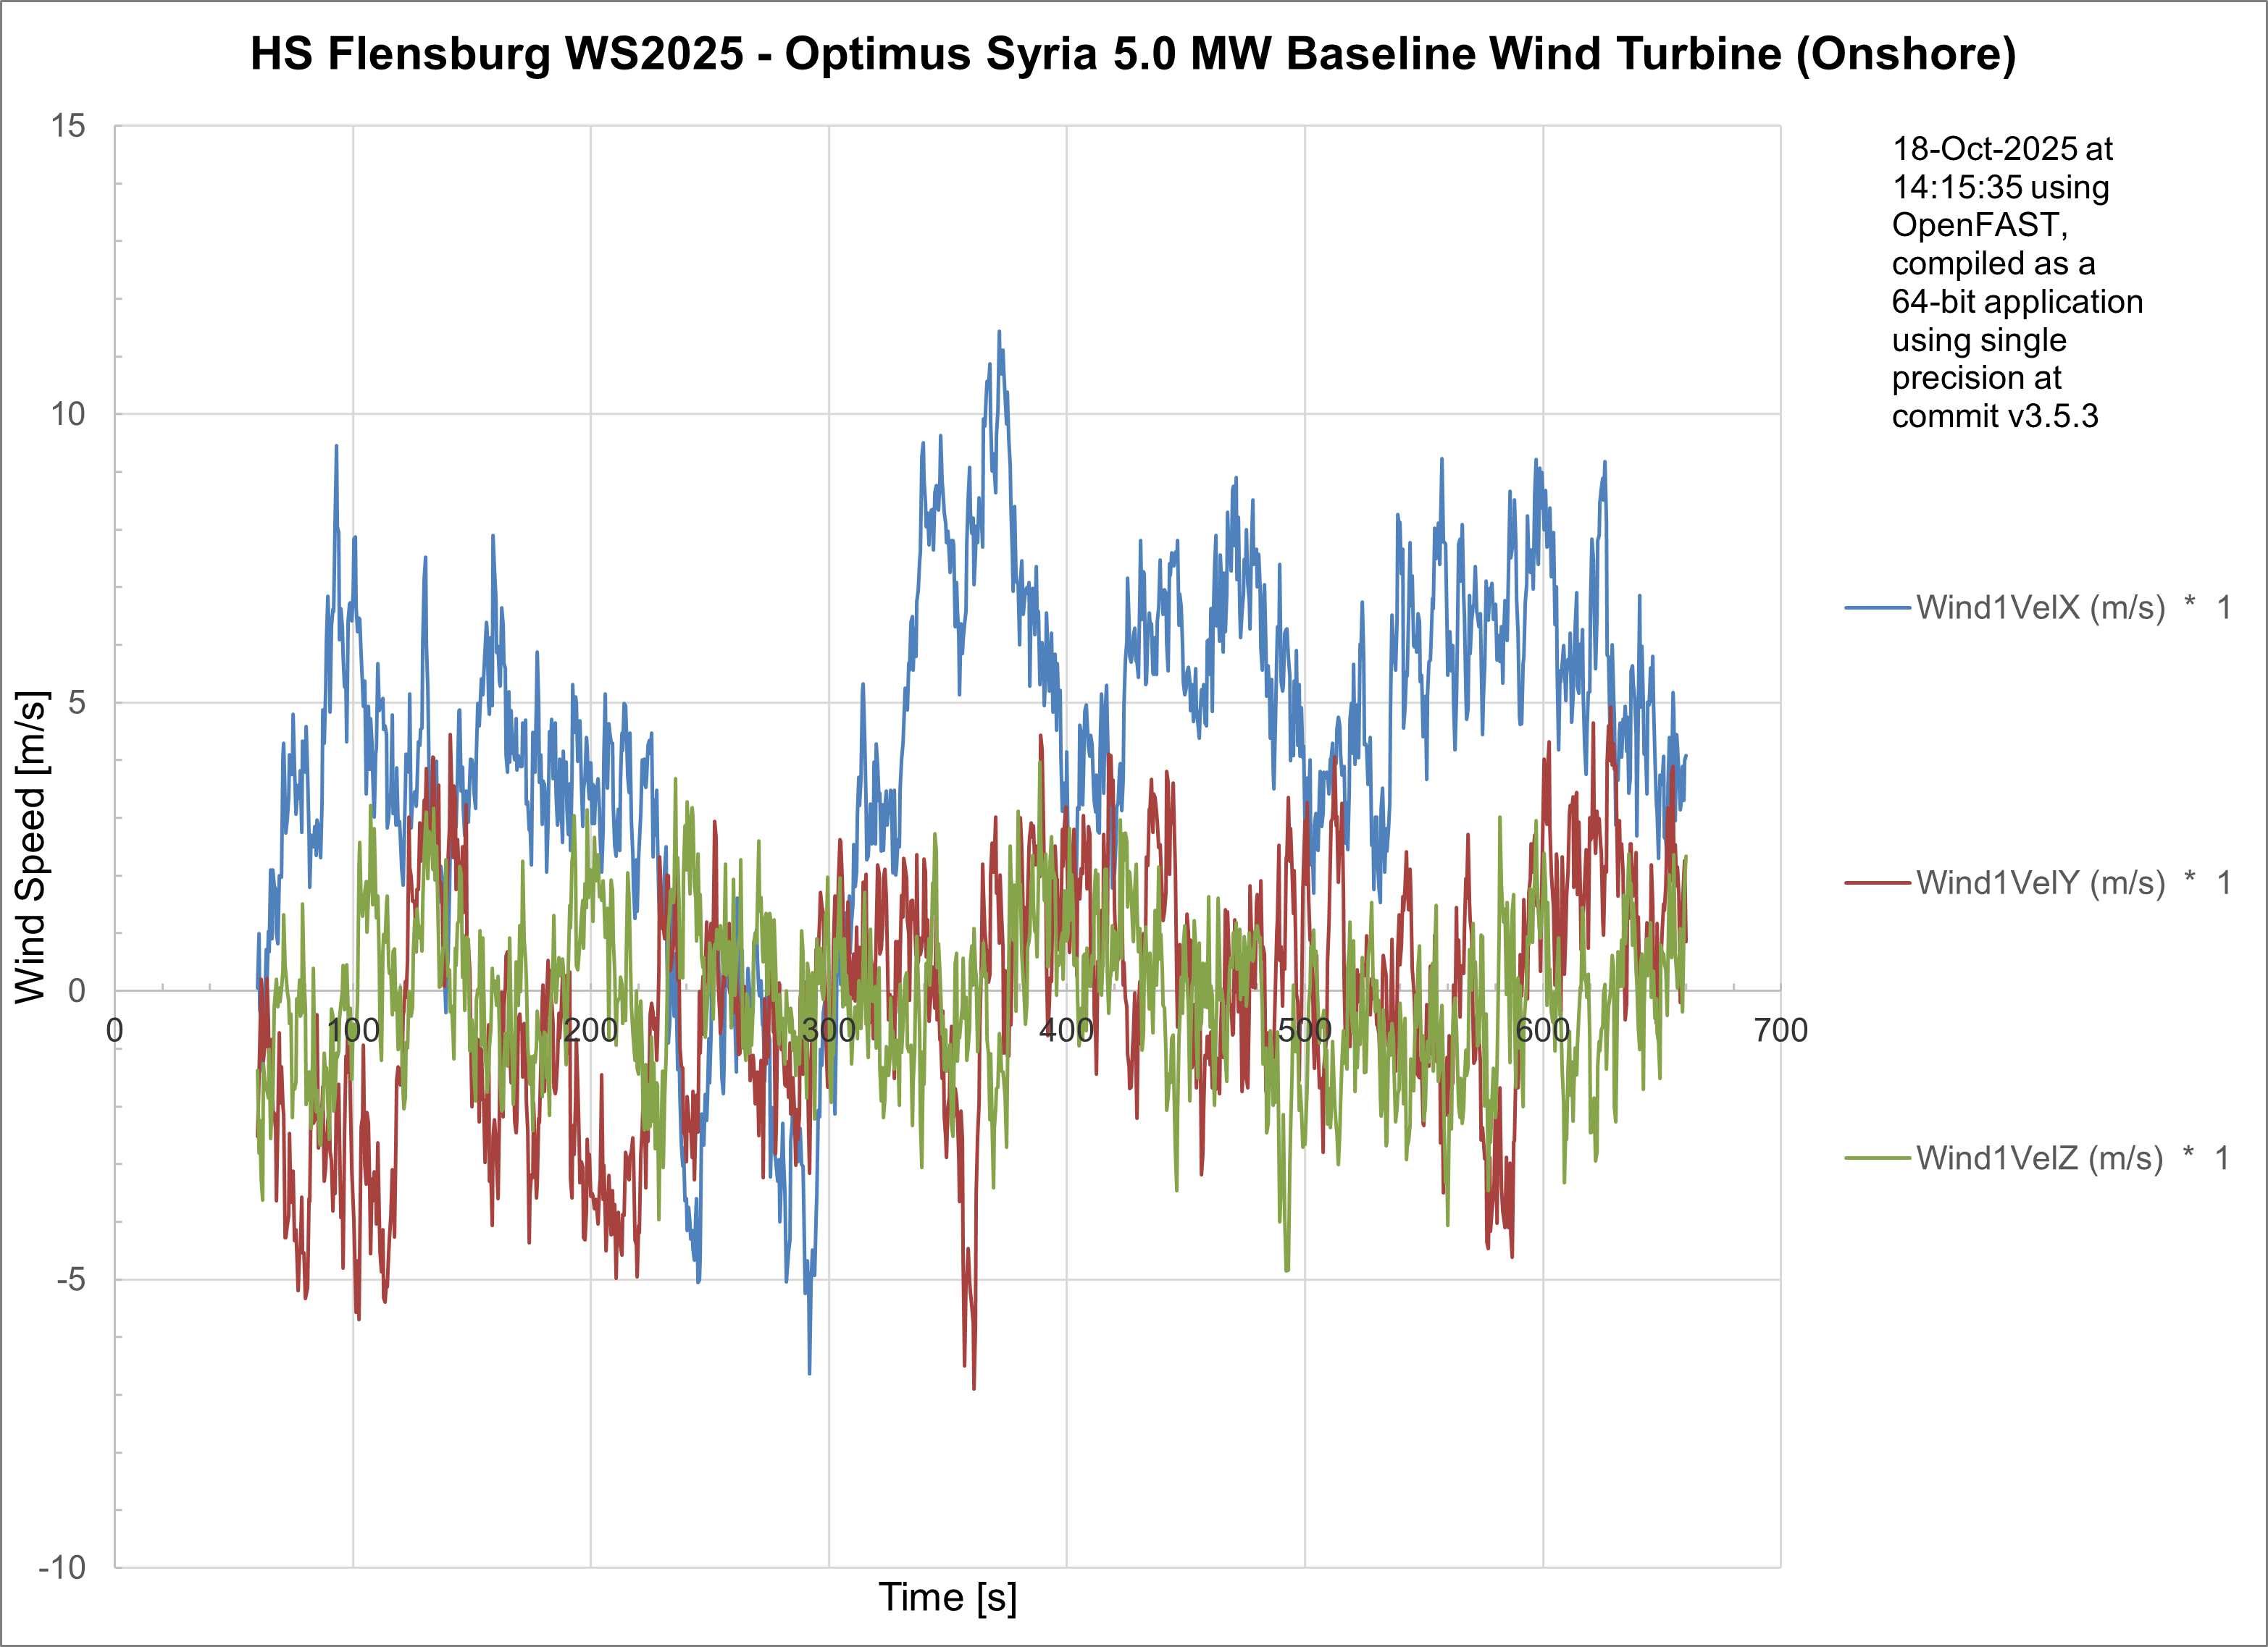
Wind Field Generation
NTM - Normal Turbulence Method for 4 m/s wind speed
ETM - Extreme Turbulence Method for 4 m/s wind speed
21/10/2025
5
Md Aman
Load & Dynamics Team/ Optimus Syria

Slide 6
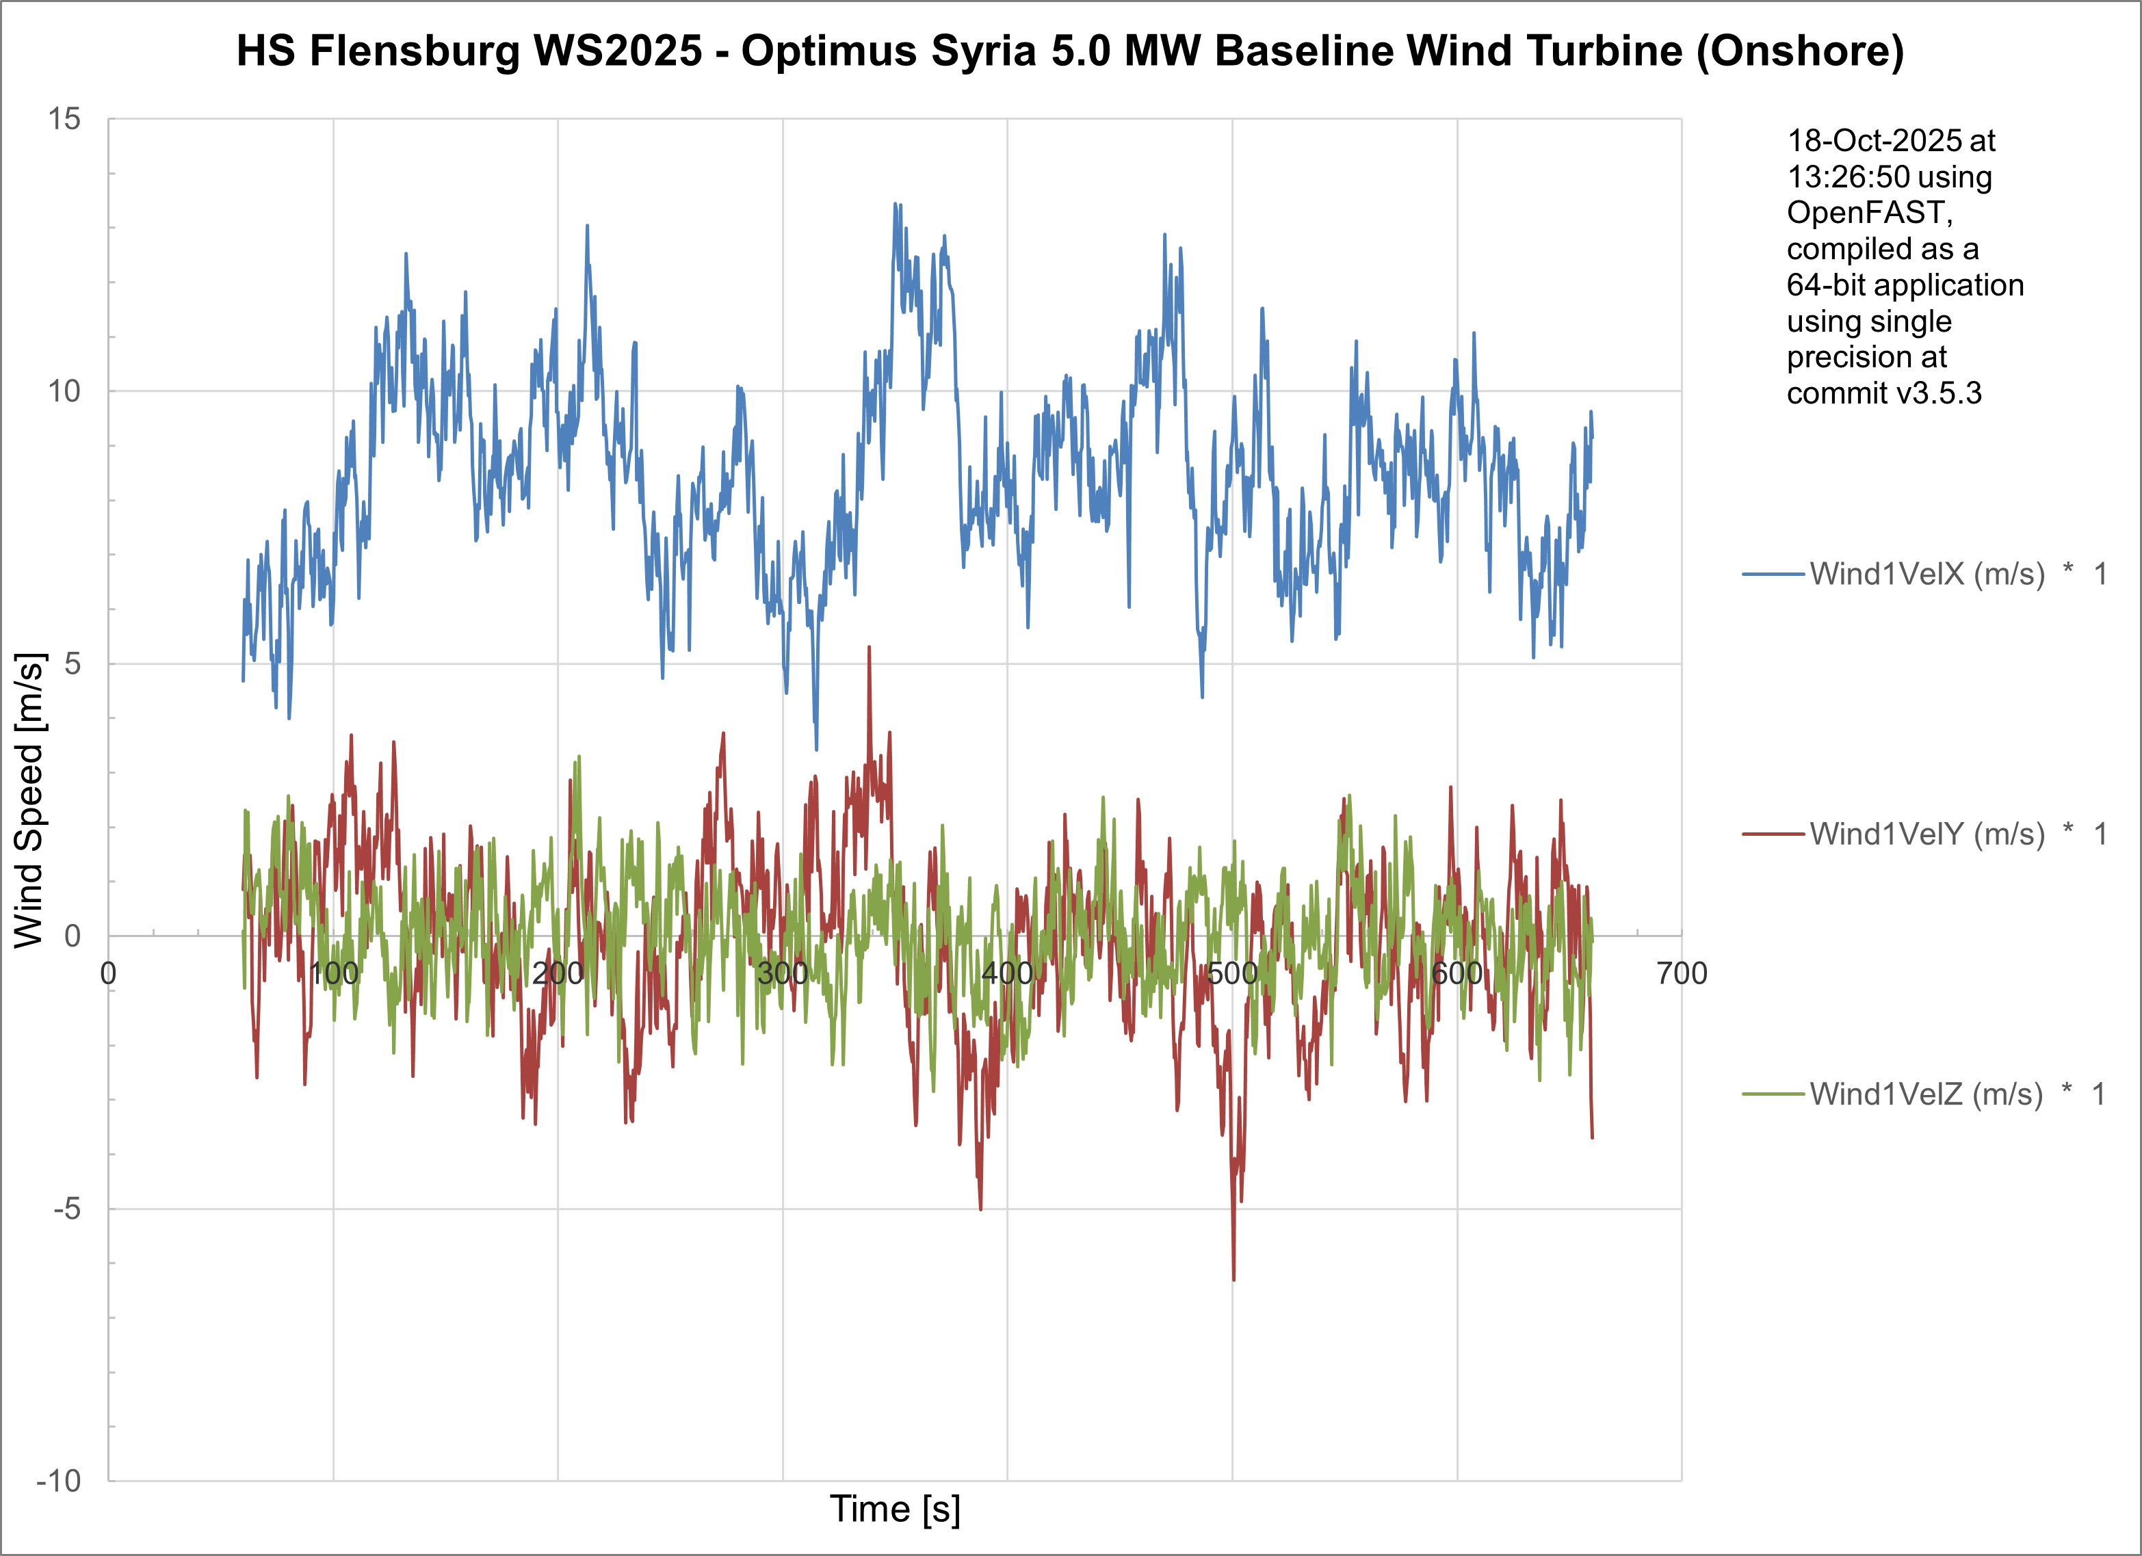
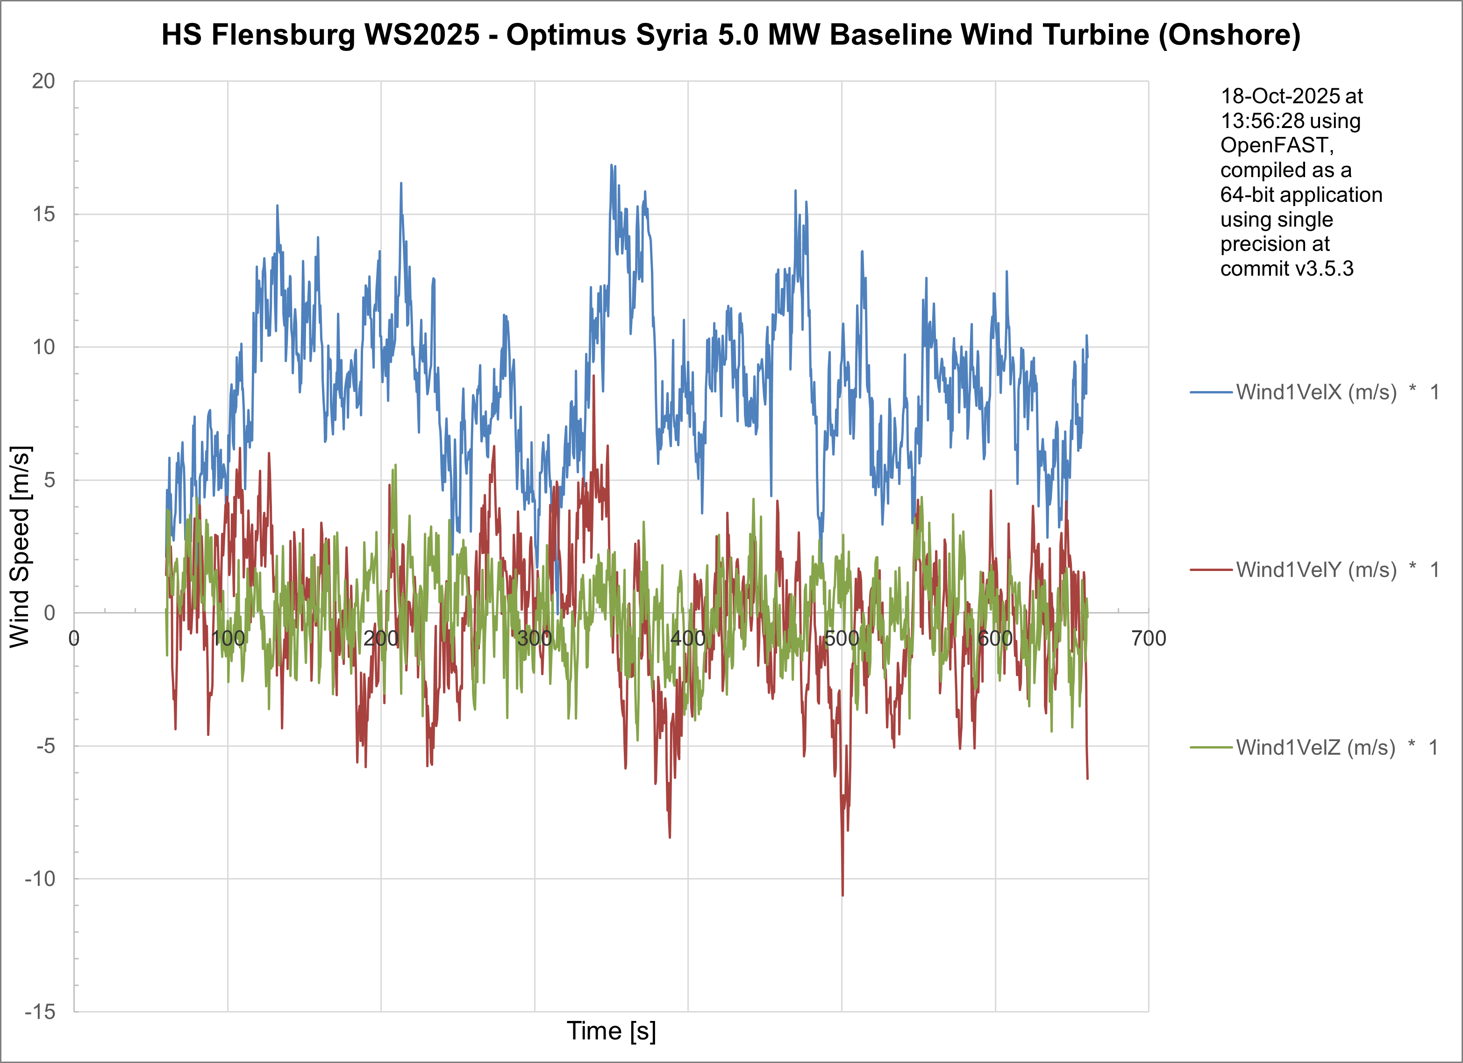
Wind Field Generation
NTM - Normal Turbulence Method for 8.64m/s annual mean wind speed
ETM - Extreme Turbulence Method for 8.64m/s annual mean speed
21/10/2025
6
Md Aman
Load & Dynamics Team/ Optimus Syria

Slide 7
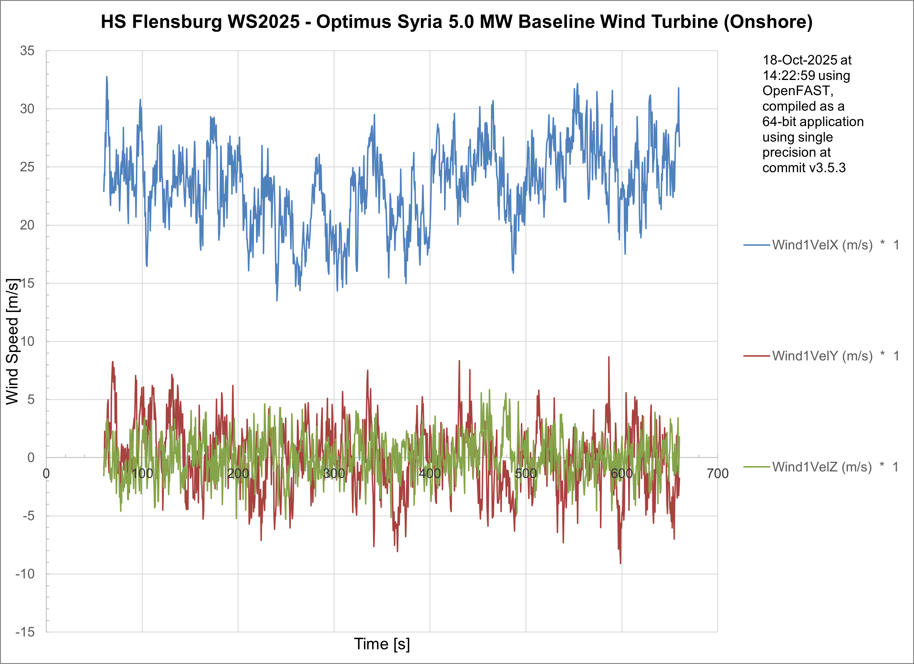
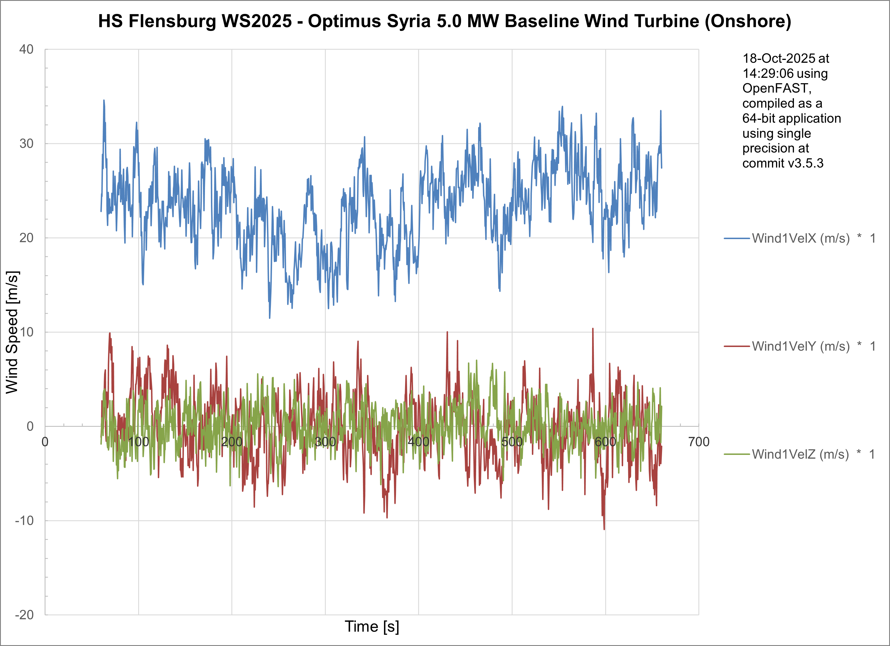
Wind Field Generation
NTM - Normal Turbulence Method for 24 m/s wind speed
ETM - Extreme Turbulence Method for 24 m/s wind speed
21/10/2025
7
Md Aman
Load & Dynamics Team/ Optimus Syria

Slide 8
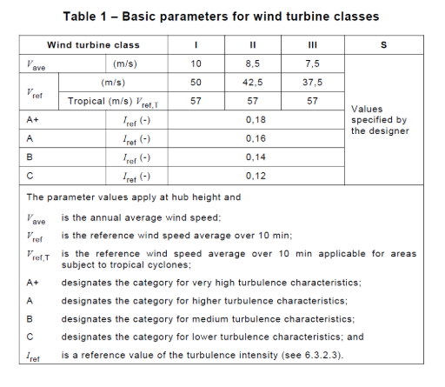
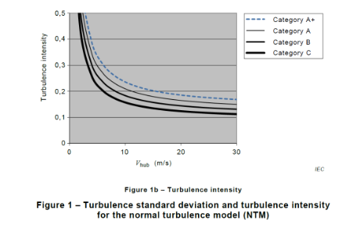
Wind Turbine Classes
Key decision OPTIMUS Syria Class IIA
* IEC 61400-1 2019-02, Ed. 4.0/ DNVGL-ST-0437 Loads and site conditions for wind turbines 11-2016
21/10/2025
8
Md Aman
Load & Dynamics Team/ Optimus Syria

Slide 9
Next Dynamic Simulations
Simulation Type | Purpose | Example Use
Normal operating (DLC 1.2) | Understand response under average turbulence | Power, pitch angles, tower motion
Extreme gusts (DLC 1.3) | Check structural limits | IEC Extreme Operating Gust (EOG)
Turbulent / stochastic (DLC 1.2) | Fatigue estimation | Damage equivalent loads (DEL)
Fault or shutdown (DLC 2.X) | Emergency events | Grid-loss, emergency stop, pitch failure
21/10/2025
9
Md Aman
Load & Dynamics Team/ Optimus Syria

Slide 10
Future Plan
In the next week we’ll
Configure OpenFast with other EWM1 & EWM50 for Syrian Condition
Create more turbulent wind fields
Start other parameters of DLC
Work with calculating forces and moments at different section of turbine with other teams
21/10/2025
10
Md Aman
Load & Dynamics Team/ Optimus Syria

Slide 11
References
Load Reports of the OPTIMUS projects
Loads and site conditions for wind turbines, DNVGL-ST-437,Edition November 2016
IEC 61400-1 2019-02, Ed. 4.0/ DNVGL-ST-0437 Loads and site conditions for wind turbines 11-2016
TurbSim, OpenFAST & NREL 5 MW
LM Wind Power, Jupitervej 6, Kolding DK-6000, Denmark
21/10/2025
11
Md Aman
Load & Dynamics Team/ Optimus Syria

